Slide 1

Pre-Filled Syringes
Benjamin Hardy

Slide 2
The Story That Took Me Ten Years To Write…
11M booked on Trauma list for I&D ankle abscess
GA LMA
Propofol, Fentanyl, Ondansetron….
…except it wasn’t ondansetron
It was undiluted phenylephrine
Cardiac Arrest

Slide 3
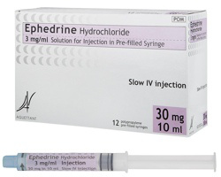
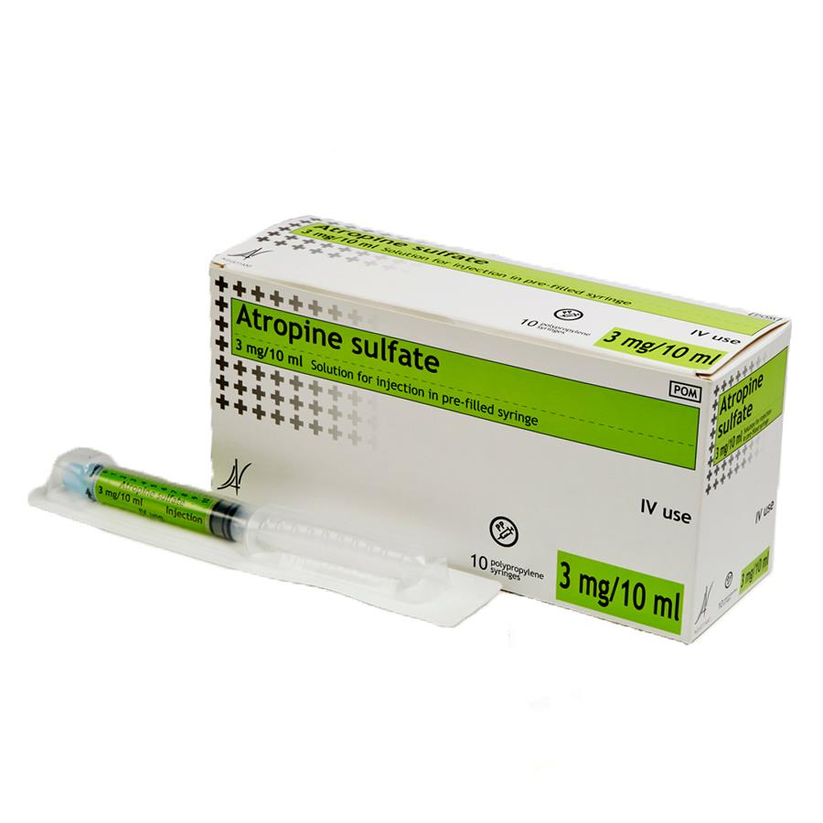
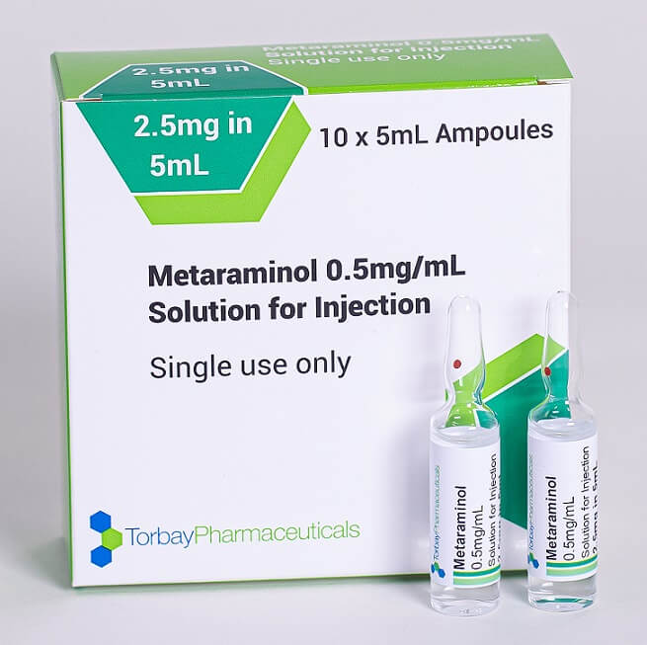
Pre-filled Syringes
Pros
Cost saving over time
Safety
Practicality
Consistent concentration
Less re-use of syringes
Environmental
Cons
Change of practice
Upfront cost

Slide 4


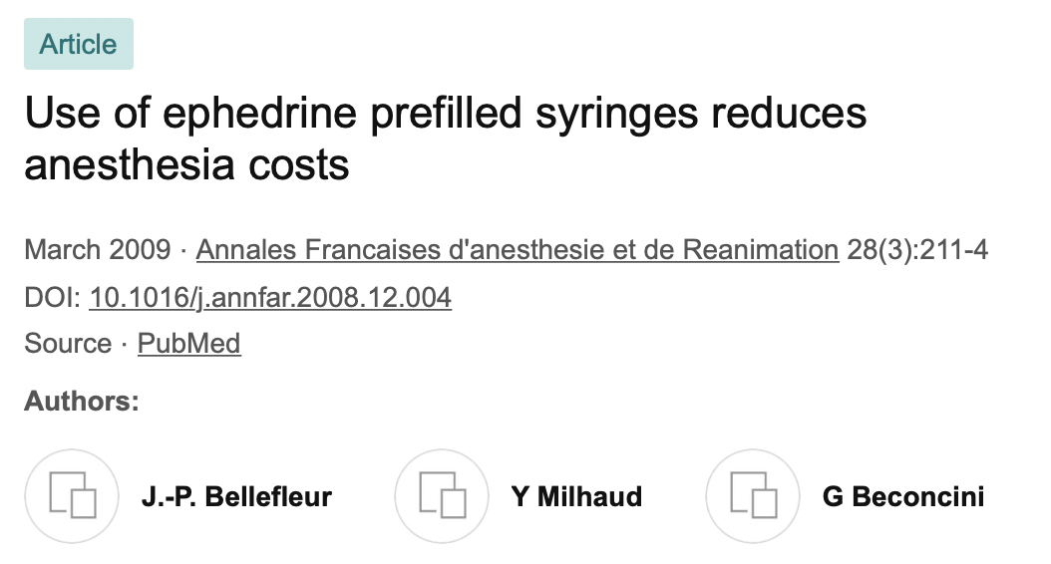

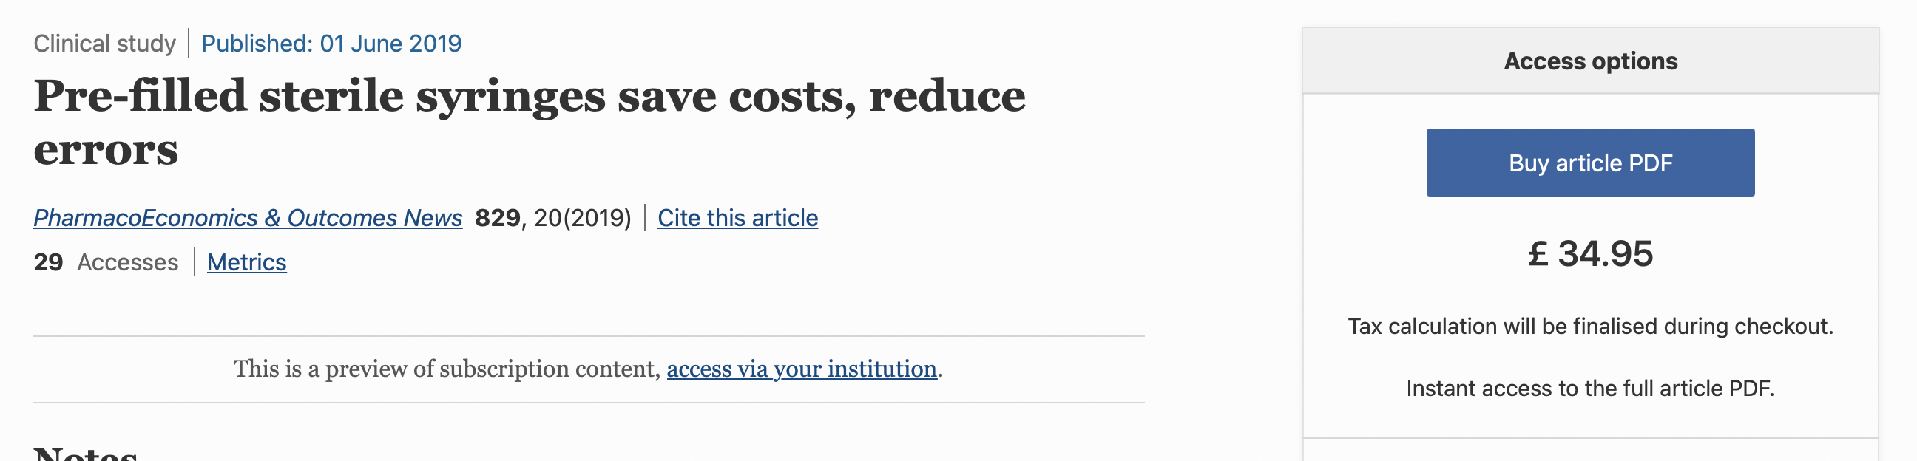
“medicines should be presented as prefilled syringes or other ‘ready-to-administer’ preparations wherever possible”
“the Working Party strongly recommends the use of drugs prepared in prefilled syringes “

Slide 5


The current status of pre-filled syringes/mix
 | Procurement | Pharmacy | In Theatres | Regular Practice
Ephedrine
Metaraminol
Atropine

Slide 6
References
How to prevent medication errors in the operating room? Take away the human factor R. S. Litman
The Letter that took me ten years to write…

